Slide 1
Databases Design. Introduction to SQL LECTURE 2 Conceptual Design
IITU, ALMATY, 2020

Slide 2
Database Design
Stages
Subject Area Analysis
Conceptual Design
Logical Design
Physical Design

Slide 3
Conceptual Modeling
ER model (entity-relationship model) is a way of graphically representing the logical relationships of entities in order to create a database.
The ER model was first proposed by Peter Chen of Massachusetts Institute of Technology (MIT) in the 1970s.

Slide 4
To design an ER model you should know …
Entities
Attributes
Relationships

Slide 5
Different types of Notations
Chen’s Notation
Bachman notation
IDEF1X
Martin notation (Crow’s foot)
min, max-notation
UML class diagram

Slide 6
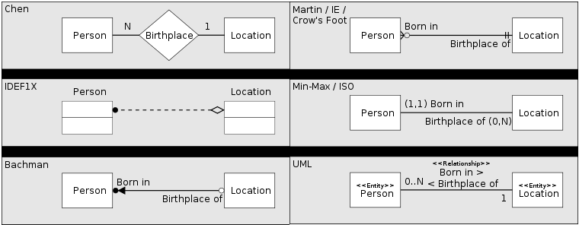
Different types of Notations
Various methods of representing the same one to many relationship. In each case, the diagram shows the relationship between a person and a place of birth: each person must have been born at one, and only one, location, but each location may have had zero or more people born at it.

Slide 7
Example: University db
Entities:
Students
Teachers
Subjects
Attributes
Students (stud_id, name, email, group)
Teachers (teach_id, name, email, department)
Subjects (subject_id, name, credits)

Slide 8



First notation - Chen’s notation
Entity (rectangle shape)
Attribute (oval shape)
Relationship (rhombus shape)

Slide 9
ER-diagram with Chen’s notation
email
name
email
department
name
Students
learn/ teach
Teachers
teach_id
stud_id
learn
teach
Subjects
credits
subject_id
name

Slide 10
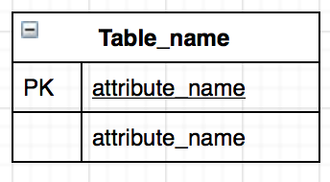
Crow’s foot notation
Crow's foot diagrams represent:
entities as boxes;
relationships as lines between the boxes;
different shapes at the ends of these lines represent the relative cardinality of the relationship (the dash represents "one ", the crow's foot represents "many" or "infinite")

Slide 11
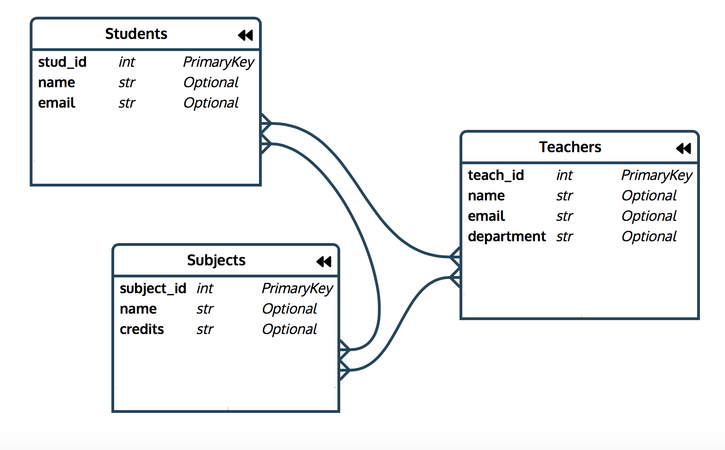
ER-diagram with Crow’s foot notation

Slide 12
Relationships
Multiplicity is the number (or range) of possible occurrences of an entity type that may relate to a single occurrence of an associated entity type through a particular relationship
Relationship types:
one-to-one (1:1)
one-to-many (1:*)
many-to-many (*:*)

Slide 13
Foreign key
Foreign key is a key used to link two tables together.
Foreign key is an attribute in one table that refers to the Primary key in another table.
The table containing the foreign key is called the child table, and the table containing the Primary key is called the referenced or parent table.

Slide 14

One-to-one
One instance of an entity (A) is associated with one other instance of another entity (B).

Slide 15
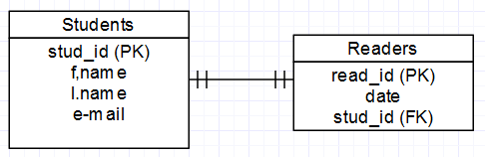
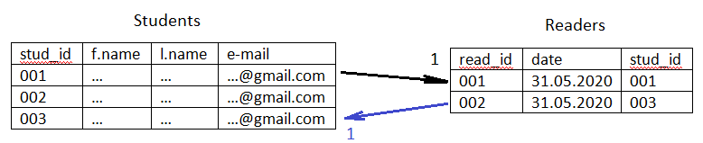
Example of one-to-one

Slide 16
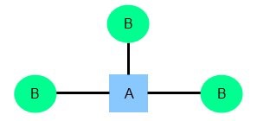
One-to-many
One instance of an entity (A) is associated with one or many instances of another entity (B), but for one instance of entity B there is only one instance of entity A.

Slide 17
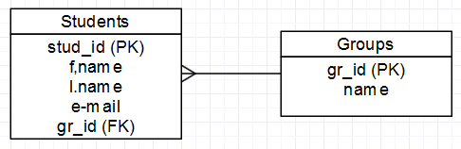
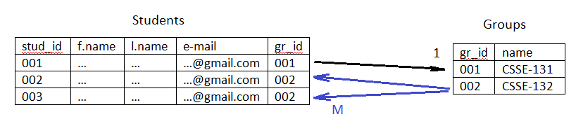
Example of one-to-many

Slide 18
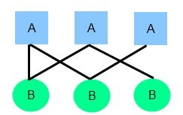
Many-to-many
One instance of an entity (A) is associated with one or many instances of another entity (B), and one instance of entity B is associated with one or many instances of entity A.

Slide 19
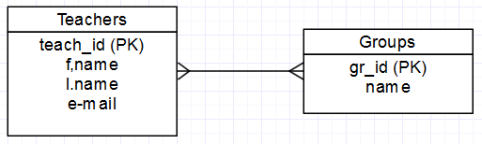
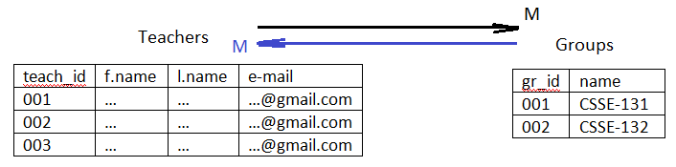
Example of many-to-many
21

Slide 20
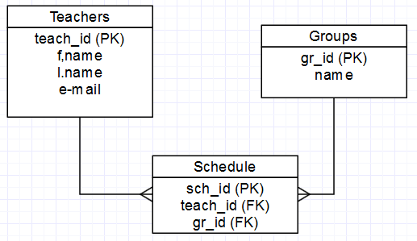
Example of many-to-many
22

Slide 21
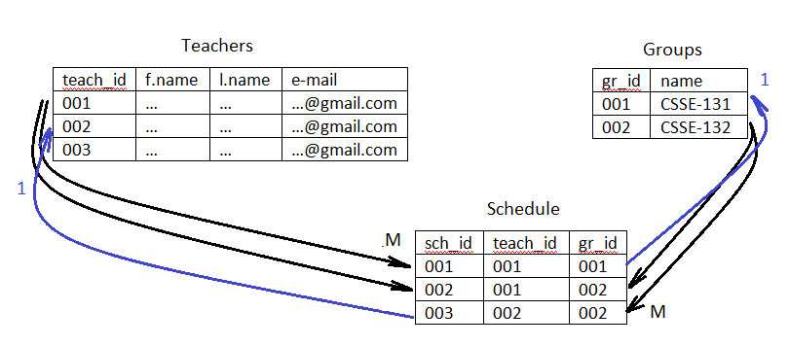
Example of many-to-many

Slide 22
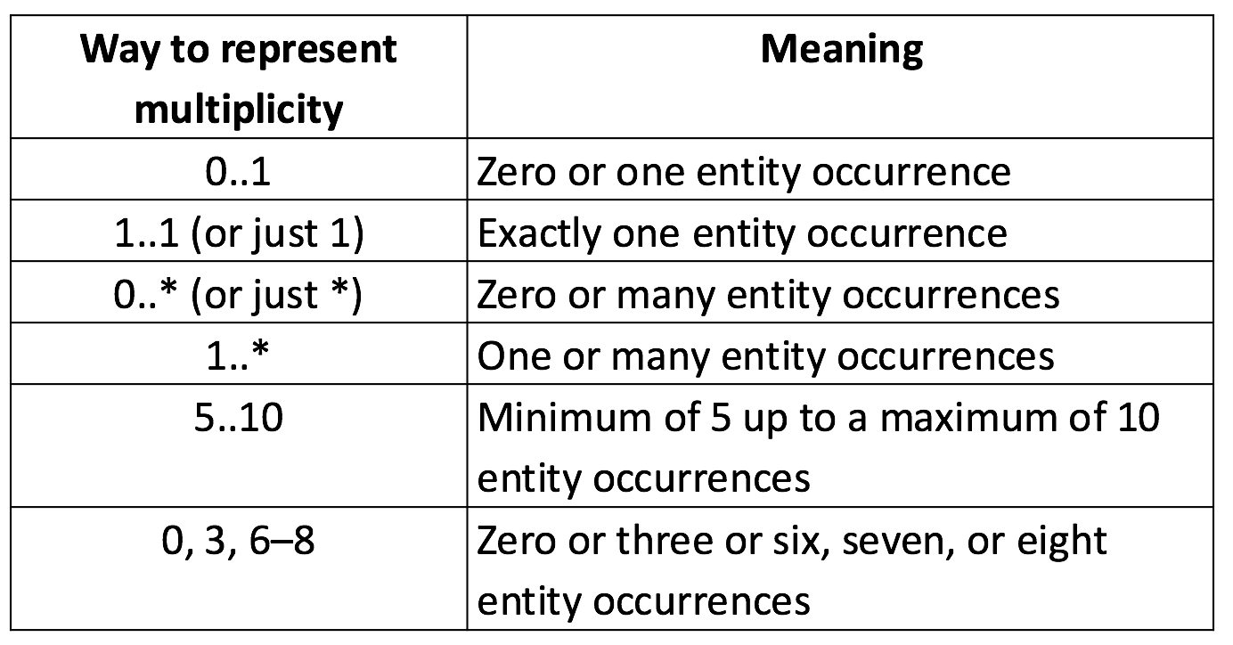
Another representation ways

Slide 23
Crow’s foot relationships
Symbols are used to represent cardinality:
the ring represents "zero"
the dash represents "one"
the crow's foot represents "many" or "infinite"
Sometimes these symbols are used in pairs. The inner component of the notation represents the minimum, and the outer component represents the maximum.
ring and dash → minimum zero, maximum one (optional)
dash and dash → minimum one, maximum one (mandatory)
ring and crow's foot → minimum zero, maximum many (optional)
dash and crow's foot → minimum one, maximum many (mandatory)

Slide 24
Tools
Gliffy.com
Lucidchart.com
Сreately.com
Draw.io
MS Visio
Erwin
etc.

Slide 25
Books
Connolly, Thomas M. Database Systems: A Practical Approach to Design, Implementation, and Management / Thomas M. Connolly, Carolyn E. Begg.- United States of America: Pearson Education
Garcia-Molina, H. Database system: The Complete Book / Hector Garcia-Molina.- United States of America: Pearson Prentice Hall
Sharma, N. Database Fundamentals: A book for the community by the community / Neeraj Sharma, Liviu Perniu.- Canada

